Slide 1
PROJECT TITLE:COMPREHENSIVE DIGITAL MARKETING FOR BOAT LIFESTYLE

Slide 2


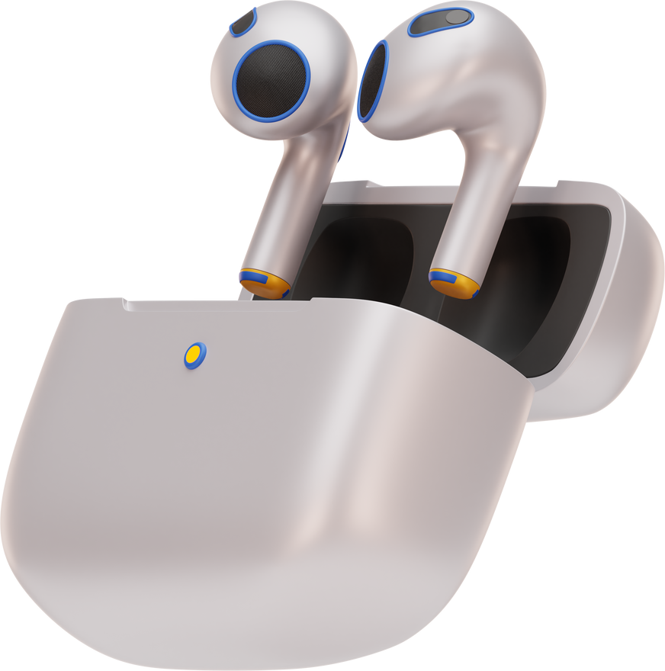
DIGITAL MARKETING STRATEGY FOR AIRPODS
PRESENTED BY : SHAIK MASEERA TABASSUM
DEPARTMENT : BSC BMC
COLLEGE : VASAVI MAHILA KALASALA
UNIVERSITY : RAYALASEEMA UNIVERSITY
MENTOR : DR HEMA SUNDARI
TEAM ID :LTVIP2025TMID21855

Slide 3
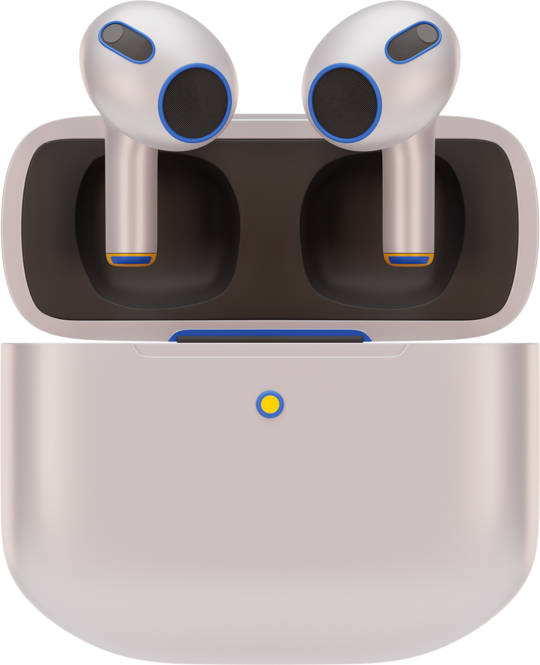
INTRODUCTION
1
BRIEF INTRODUCTION TO AIRPODS AS A PREMIUM WIRELESS EARPHONE BRAND.
2
OVERVIEW OF APPLE’S POSITION IN THE WIRELESS AUDIO MARKET.

Slide 4

MARKET ANALYSIS
Target Audience: Tech-savvy users, Apple ecosystem users, music lovers, fitness enthusiasts.
Competitor Analysis: Sony, Bose, Samsung Galaxy Buds.
Market Trends: Growing demand for wireless audio, noise cancellation, and smart integration

Slide 5

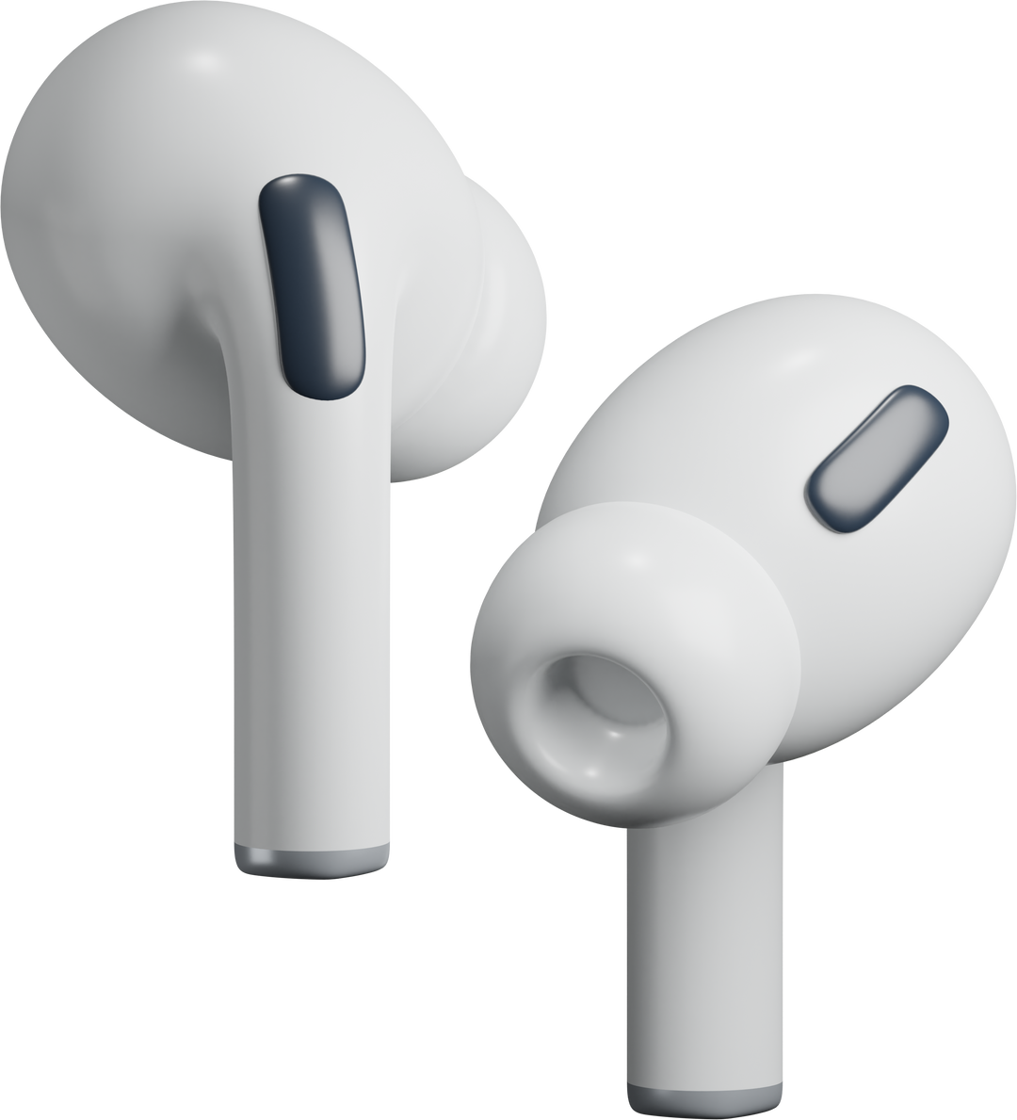
DIGITAL MARKETING GOALS
INCREASE BRAND AWARENESS.
BOOST ONLINE SALES AND ENGAGEMENT.
STRENGTHEN CUSTOMER LOYALTY.

Slide 6




DIGITAL MARKETING CHANNELS
SOCIAL MEDIA MARKETING: INSTAGRAM, FACEBOOK, TIKTOK, TWITTER.
SEARCH ENGINE MARKETING (SEM): GOOGLE ADS, YOUTUBE ADS.
CONTENT MARKETING: BLOGS, INFLUENCER COLLABORATIONS, UNBOXING VIDEOS.
EMAIL MARKETING: PERSONALIZED PROMOTIONS, PRODUCT LAUNCH UPDATES.
AFFILIATE & INFLUENCER MARKETING: TECH INFLUENCERS, GADGET REVIEWERS.
INSTAGRAM
FACEBOOK
TWITTER
GOOGLE ADS

Slide 7
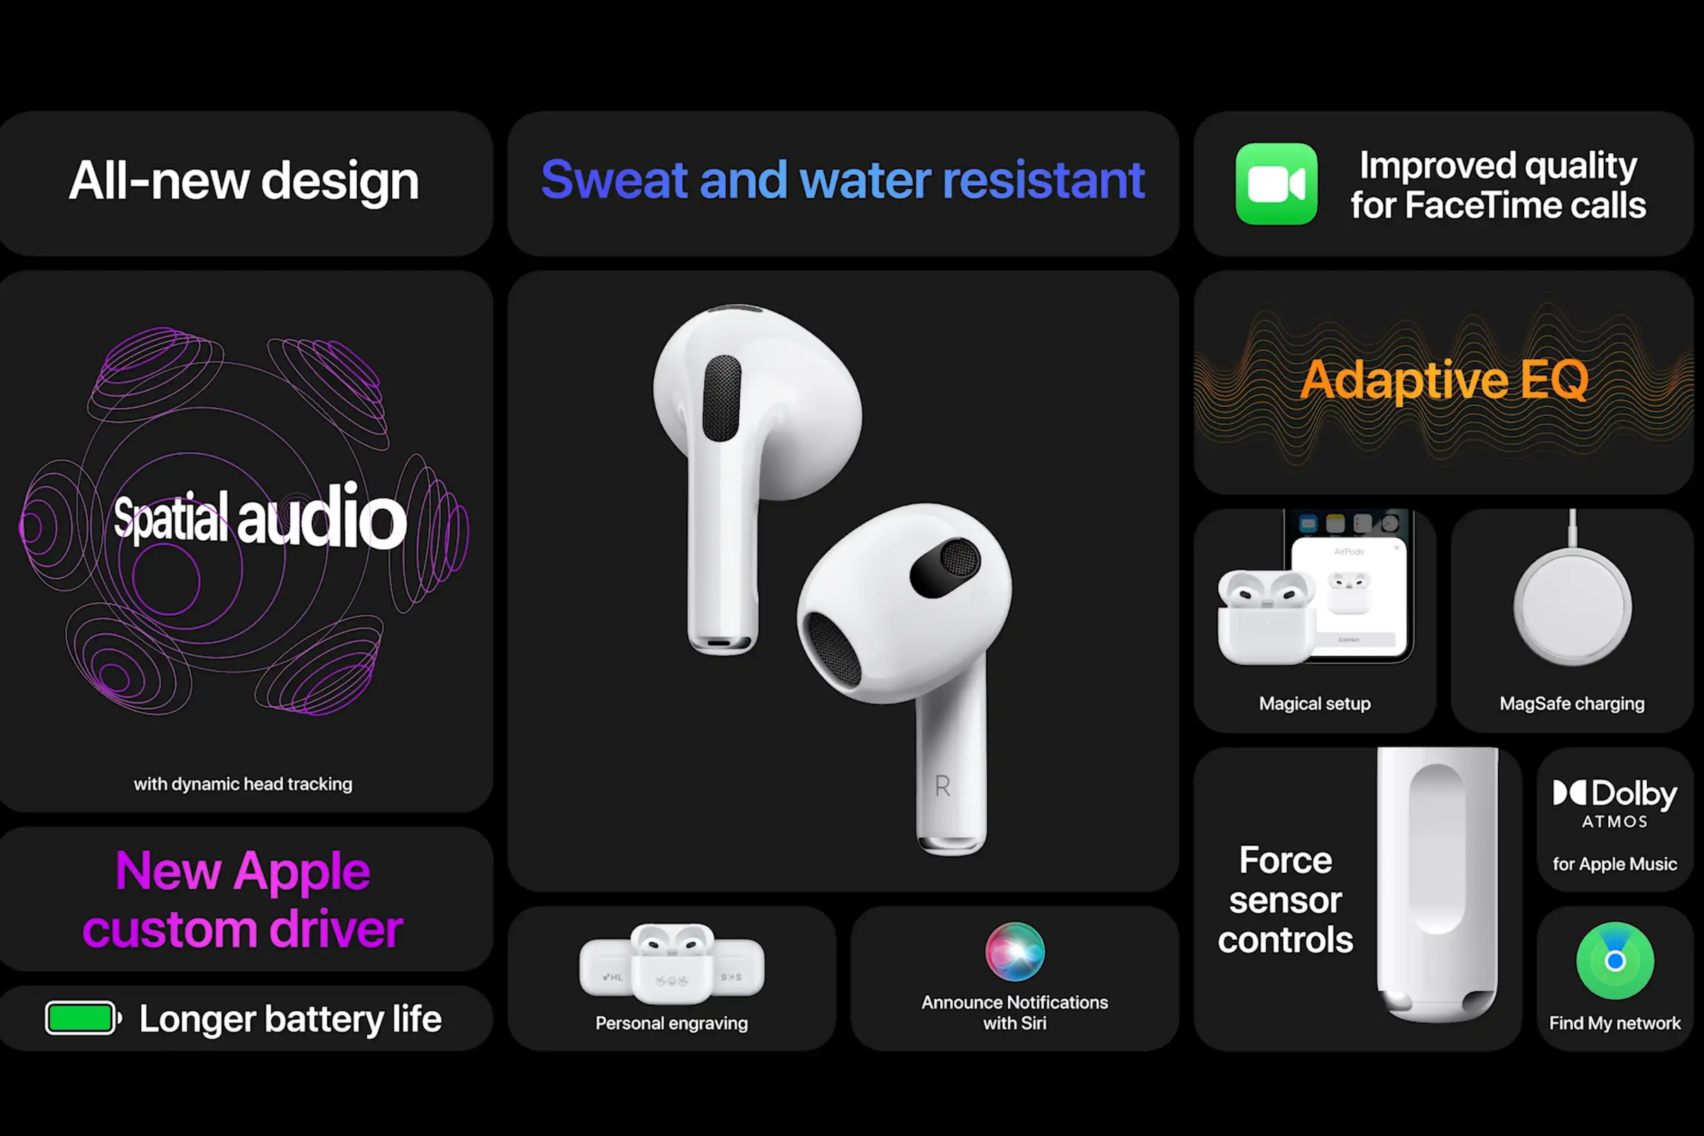

Slide 8

SEO & CONTENT MARKETING
LOG POSTS ON AIRPODS FEATURES, COMPARISONS, AND TIPS.
WEBSITE OPTIMIZATION FOR SEARCH RANKINGS.
VIDEO CONTENT: TUTORIALS, CUSTOMER REVIEWS.

Slide 9
SOCIAL MEDIA STRATEGY

Slide 10

EMAIL & RETARGETING STRATEGY
Personalized emails with product recommendations.
Retargeting ads for visitors who didn’t purchase.
Exclusive discounts for loyal customers.

Slide 11
PERFORMANCE METRICS & KPIS
SOCIAL MEDIA ENGAGEMENT & REACH.
AD CAMPAIGN ROI.
WEBSITE TRAFFIC & CONVERSION RATES.
CUSTOMER RETENTION & SATISFACTION SCORES

Slide 12
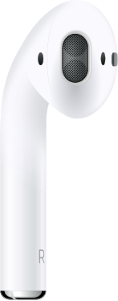
THANK YOU

